Slide 1
SOFTWARE PLAYGROUND
Digital Cockpit Project for Smart Vehicle

Slide 2
Contents
1. Project Information
2. System Information
3. Device Information
4. UseCaseDemo
5. WarpUp

Slide 3
1. Project Information
1.1 Overview
1.2 Scope
1.3 Schedule
1.4 Cost
1.5 Quality
1.6 Human Resource
1.7 Communication
1.8 Risk
1.9 Procurement
1.10 Stakeholder

Slide 4
1.1 Project Overview
Background::Mega Trend

Slide 5
1.1 Problems
Industrial Issues

Slide 6
1.1 Solutions
Research and Business Development

Slide 7
1.1 Solutions
Product and Service

Slide 8
1.1 Approach
Startup

Slide 9
1.2 Project Scope
General

Slide 10
1.3 Project Schedule
General

Slide 11
1.4 Project Cost
General

Slide 12
1.5 Project Cost
General

Slide 13
1.6 Project Cost
General

Slide 14
1.7 Project Cost
General

Slide 15
1.8 Project Cost
General

Slide 16
1.9 Project Cost
General

Slide 17
1.10 Project Cost
General

Slide 18

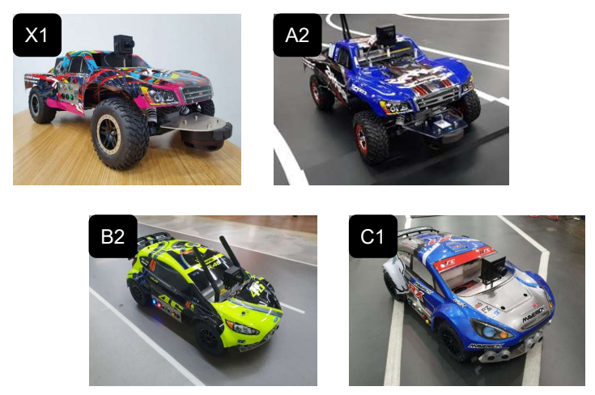
2. System Information
2.1 Overview
2.2 Features
2.3 Specifications
2.4 Usecases
2.5 Applications
2.6 Appendix

Slide 19
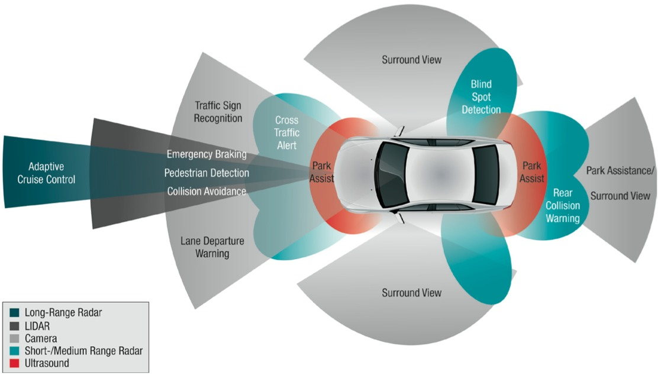
2.1 System Overview
General Overview(1)

Slide 20
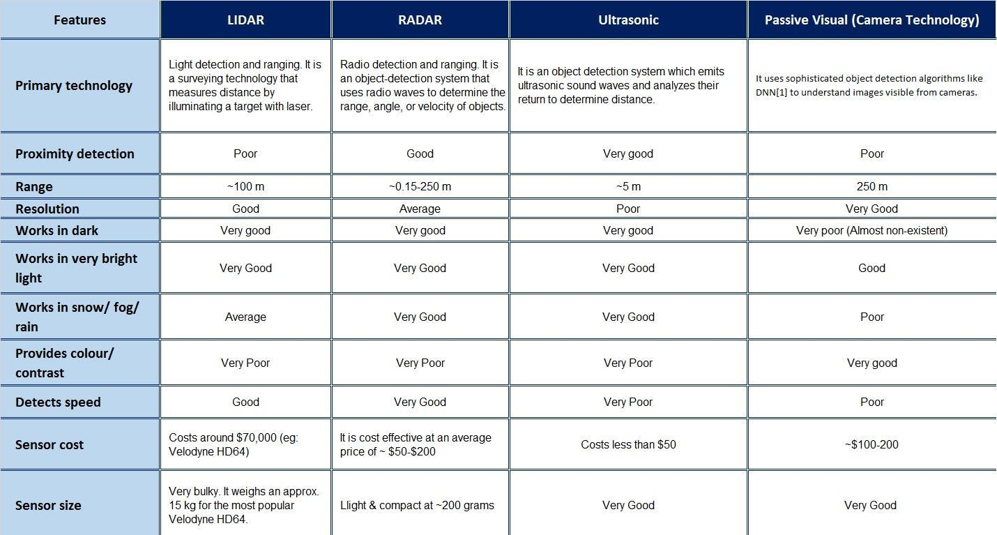
2.2 System Features
Key Feature(1)

Slide 21
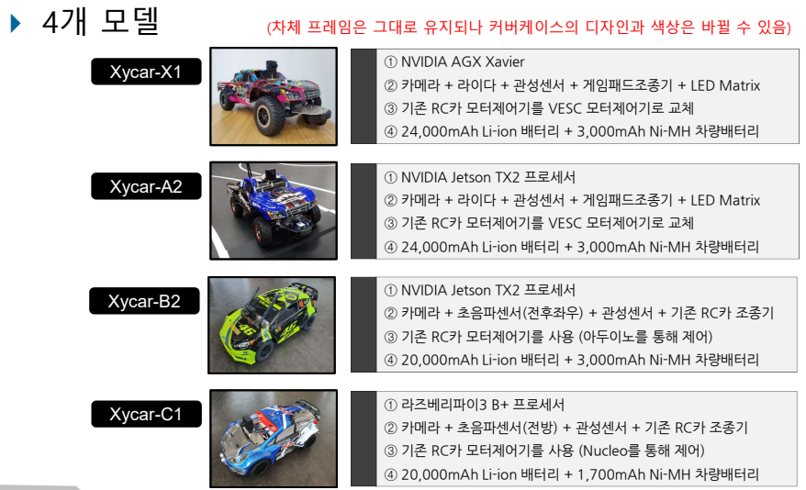
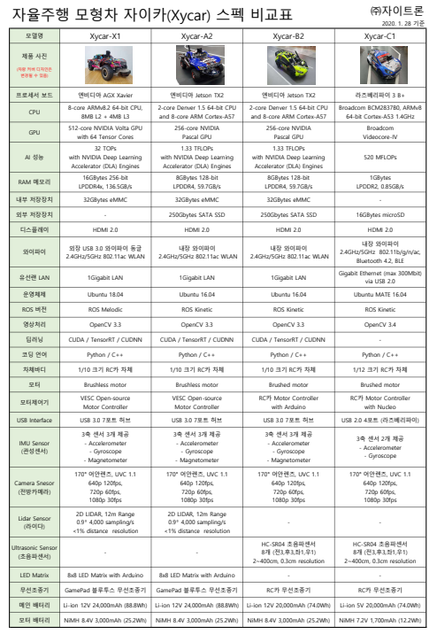
2.2 System Features
Key Feature(2)

Slide 22
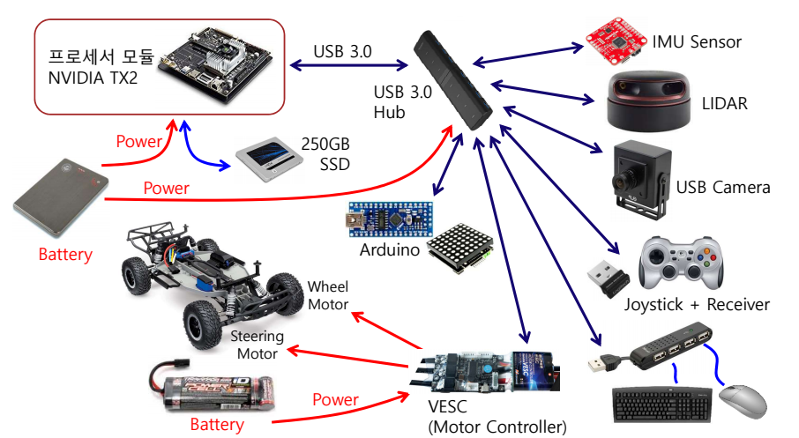
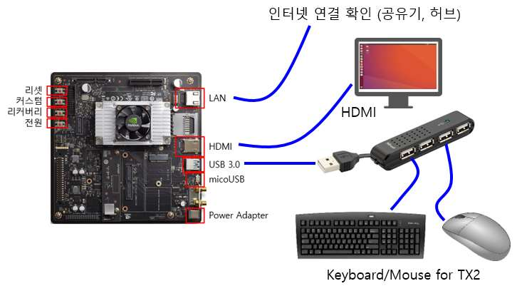
2.3 System Specifications
Configuration

Slide 23
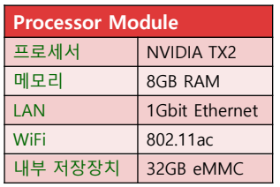
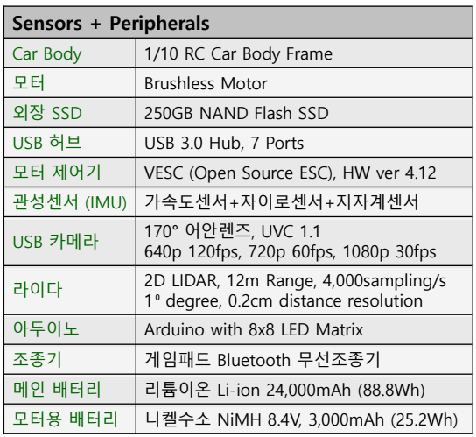
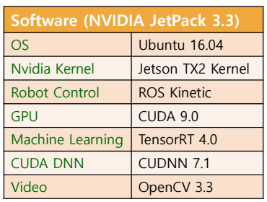
2.3 System Specifications
Hardware

Slide 24
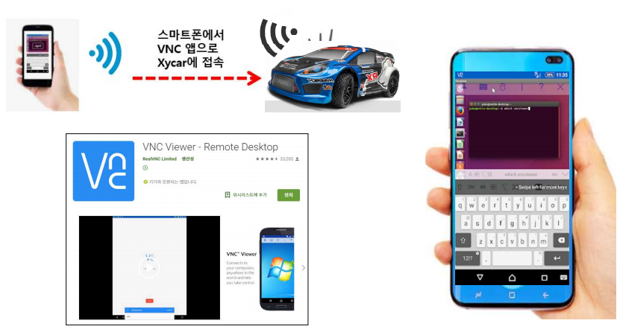
2.3 System Specifications
Software

Slide 25
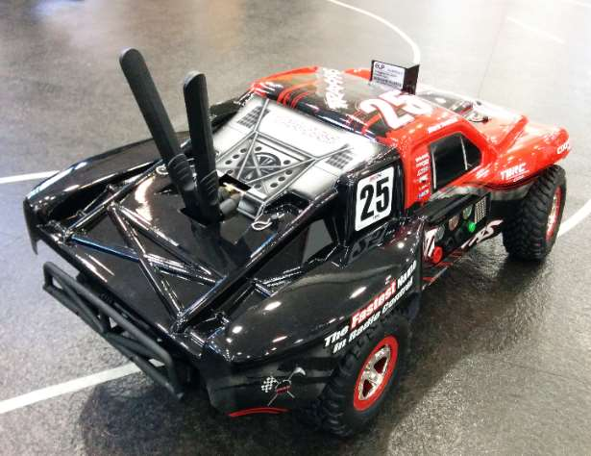
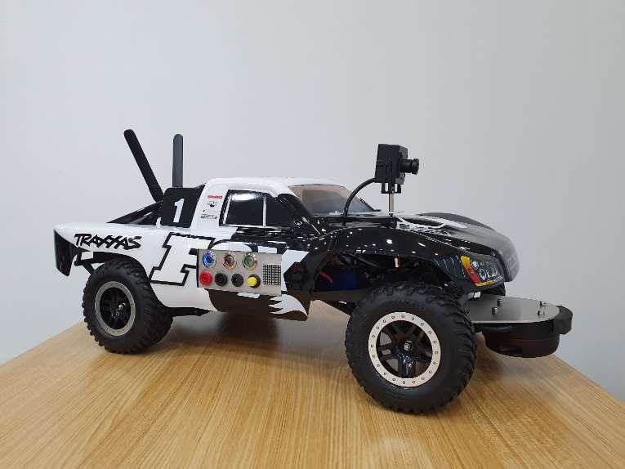
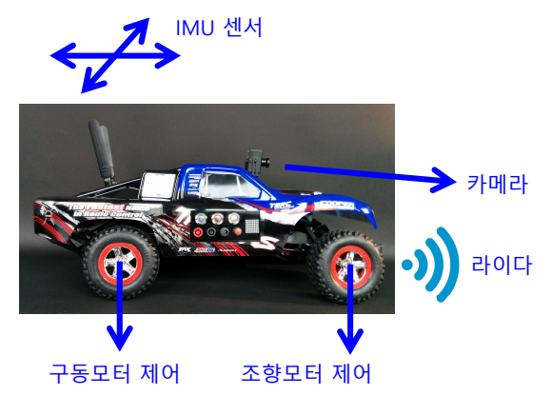
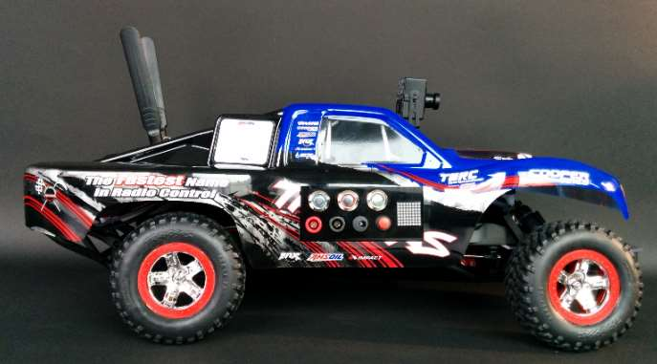
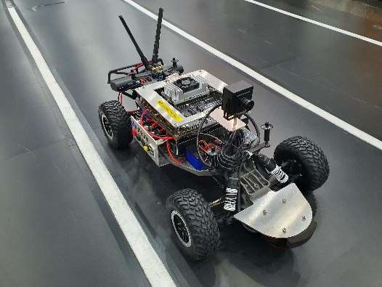
2.3 System Specifications
Mechanical

Slide 26
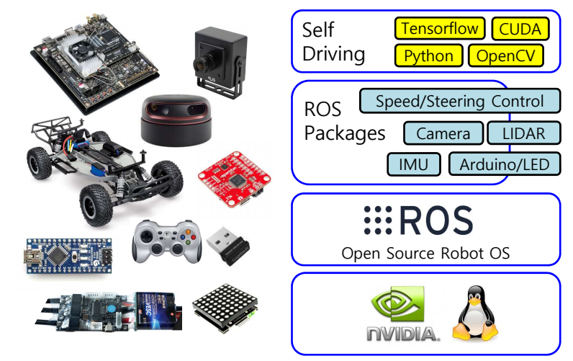
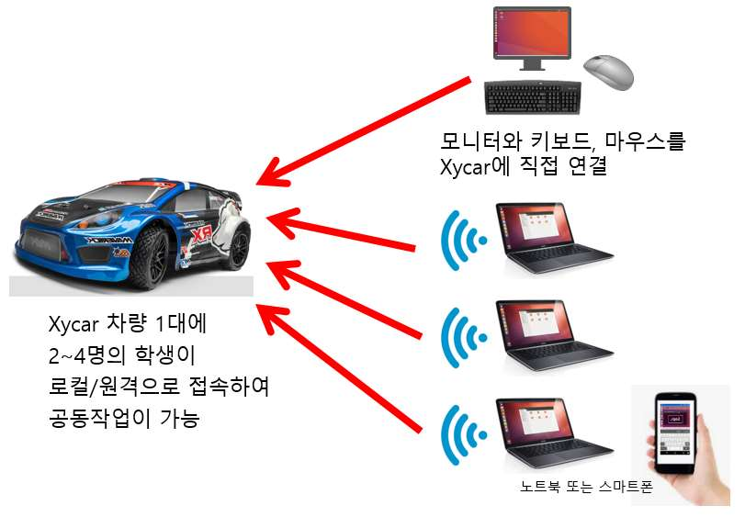
2.3 System Specifications
Monitorung

Slide 27
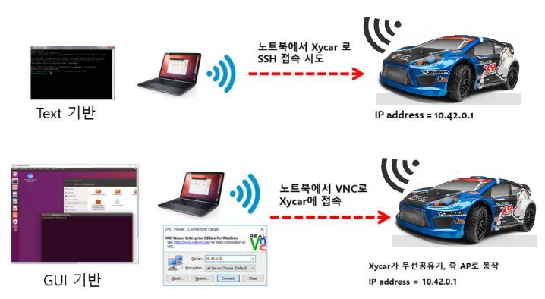
2.3 System Specifications
Monitorung

Slide 28
2.3 System Specifications
Monitorung

Slide 29
2.3 System Specifications
Monitorung

Slide 30
2.3 System Specifications
Monitorung

Slide 31
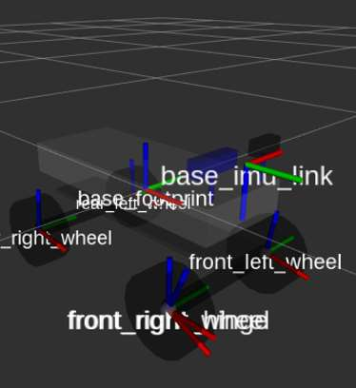
2.4 System Usecases
01 Smart Vehicles and Smart Car

Slide 32
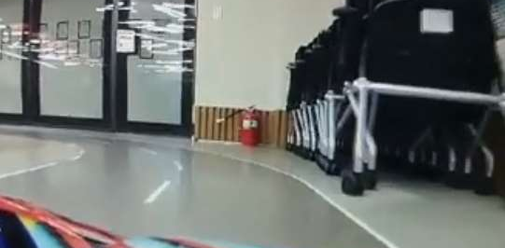
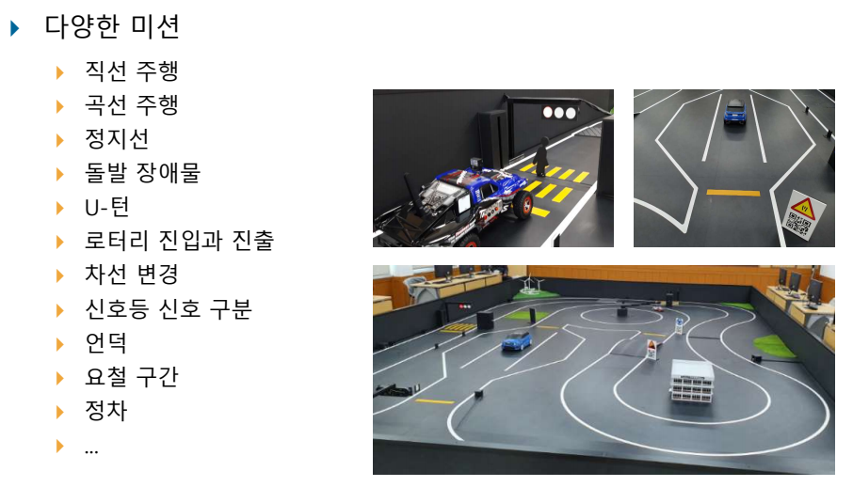
2.5 System Applications
Smart Vehicles and Autonomous Driving

Slide 33
2.5 System Applications
Smart Home and Smart Cities

Slide 34
2.5 System Applications
IoT

Slide 35
2.6 Appendix
General

Slide 36
3. Device Information
3.1 Vesc
3.2 InertialMU
3.3 UltrasonicMU
3.4 LidarMU
3.5 RadarMU
3.6 Camera

Slide 37
3.1 Component Device Module[Vesc]
General

Slide 38
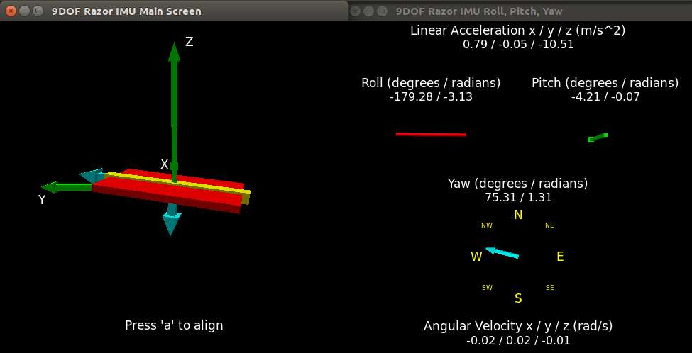
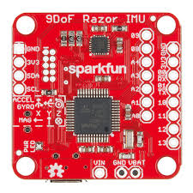
3.2 Component Device Module[InertialMU]
General

Slide 39
3.3 Component Device Module[UltrasonicMU]
General

Slide 40
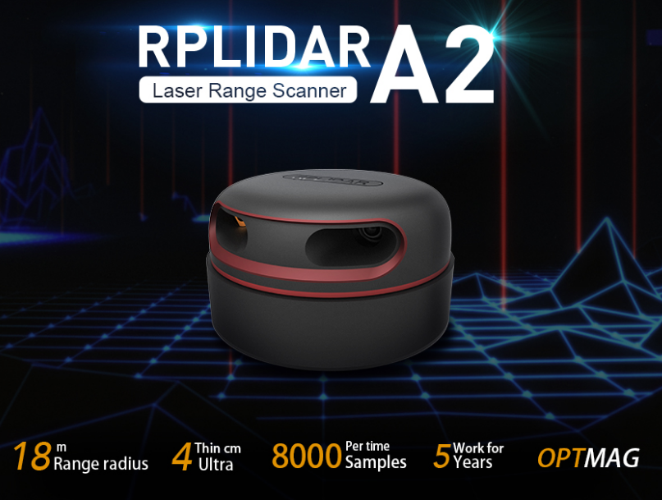
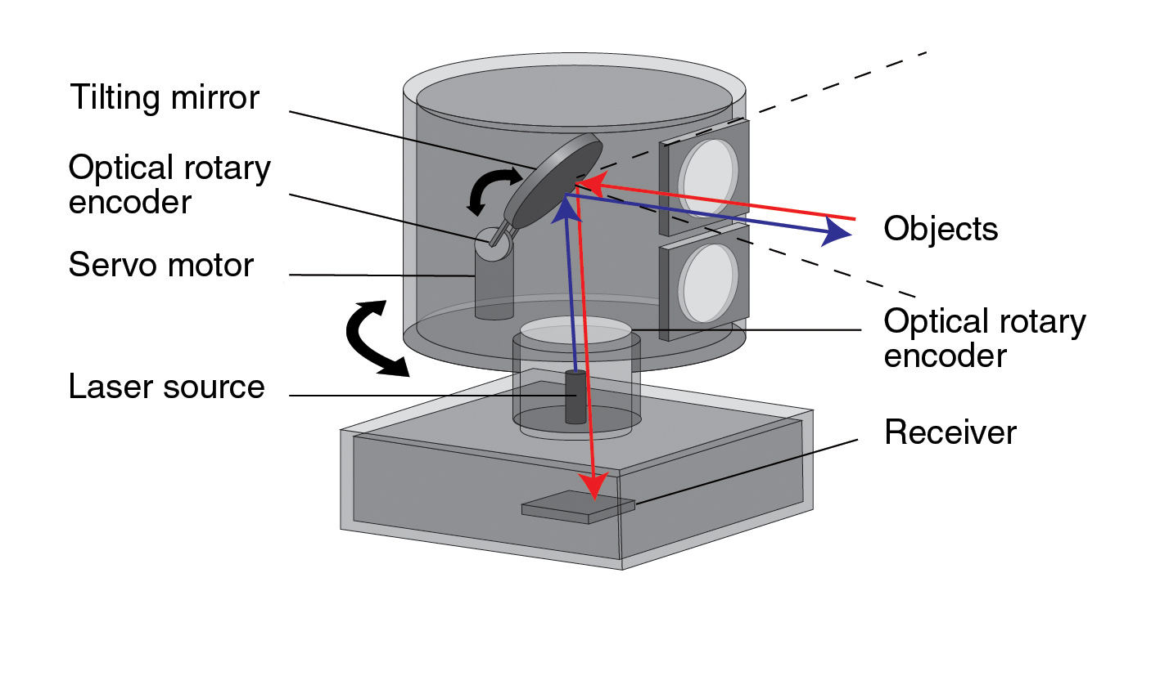
3.4 Component Device Module[LidarMU]
General

Slide 41
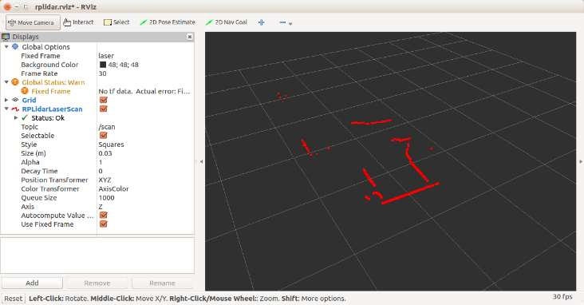
3.4 Component Device Module[LidarMU]
General

Slide 42
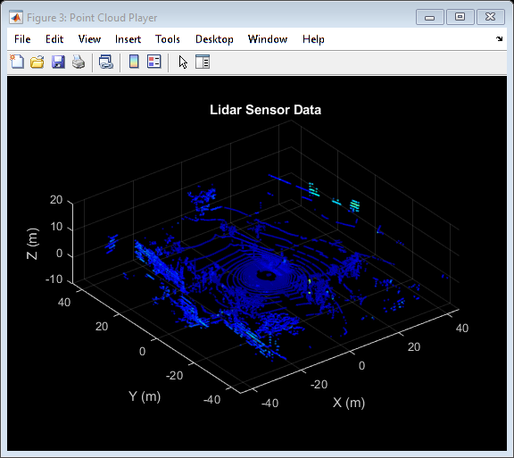
3.4 Component Device Module[LidarMU]
General

Slide 43
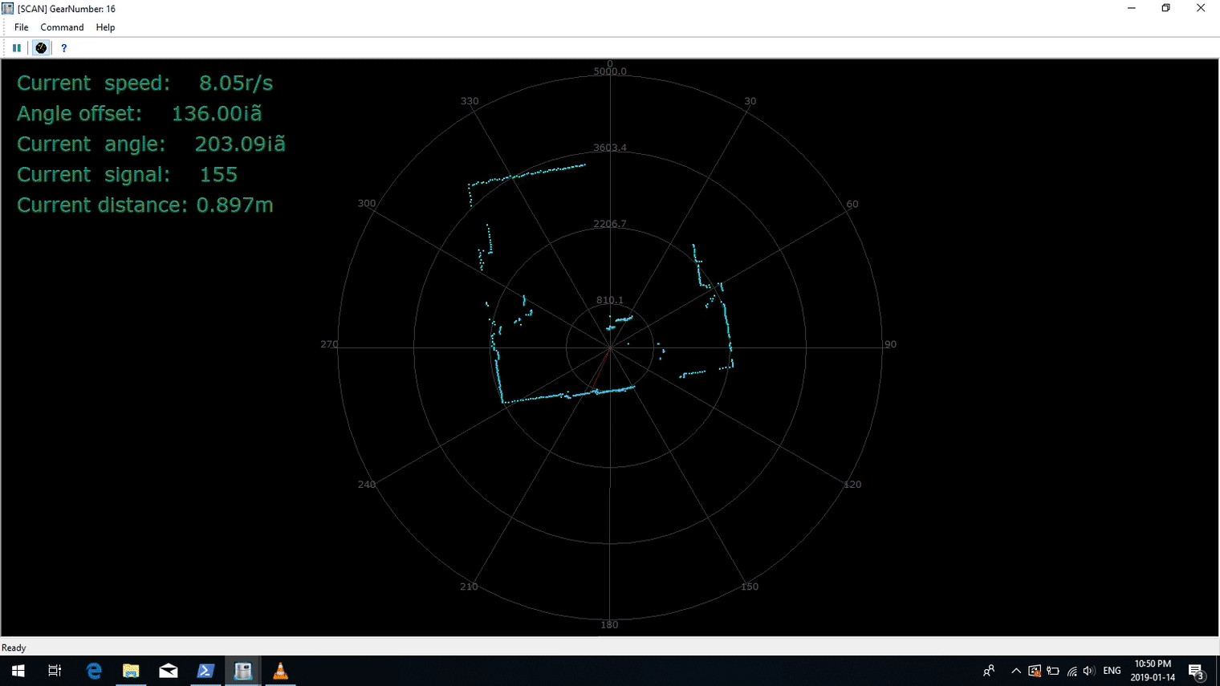
3.4 Component Device Module[LidarMU]
General

Slide 44
3.5 Component Device Module[RadarMU]
General

Slide 45
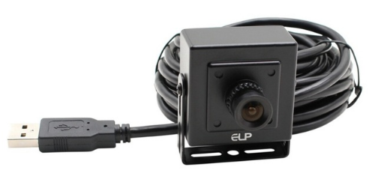
3.6 Component Device Module[Camera]
General

Slide 46
3.7 Component Device Module[Wireless Controller]
General

Slide 47
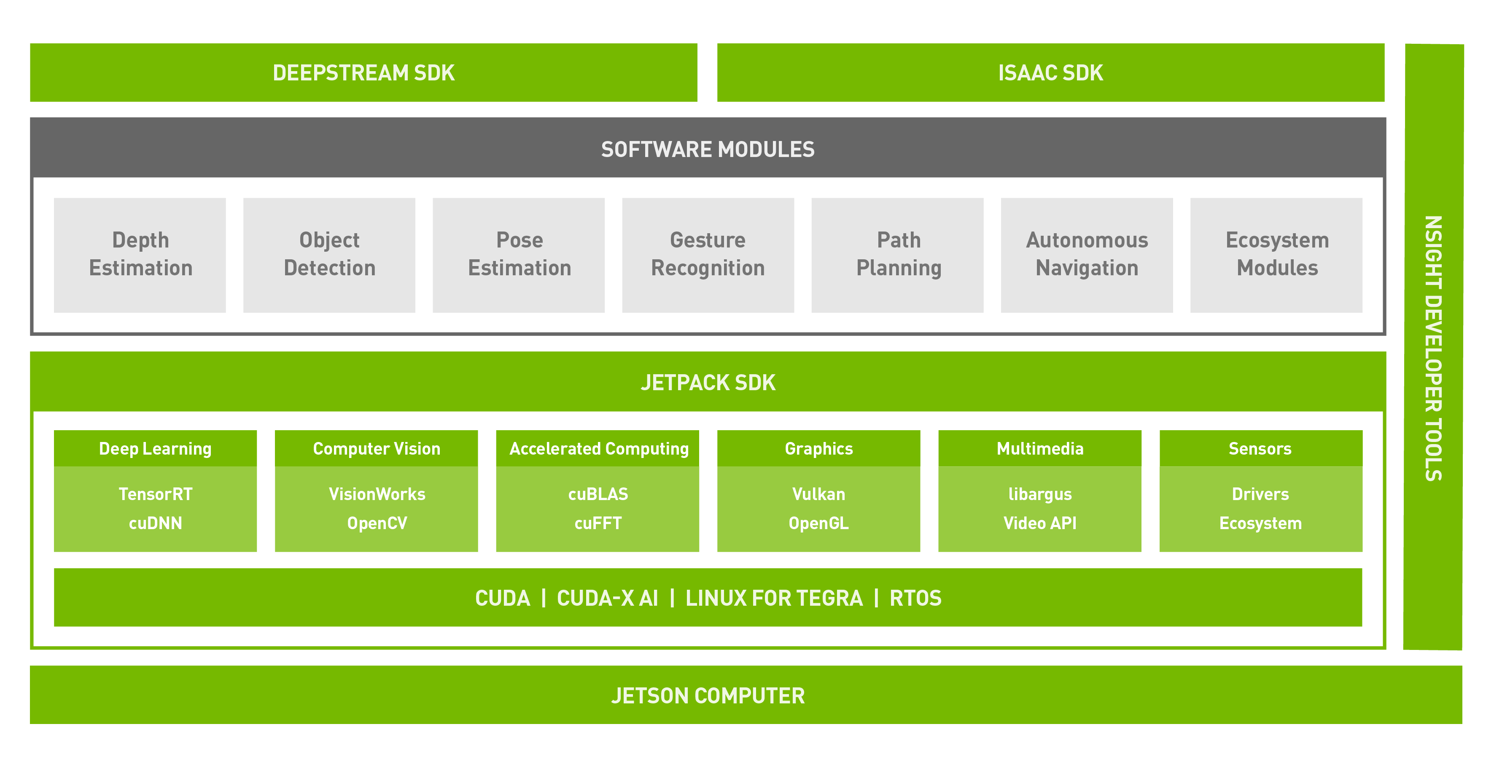
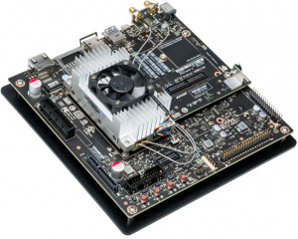
3.7 Component Device Module[nVidia TX2 Main Computer]
General

Slide 48
4. UseCaseDemo
4.1 VESC
4.2 UltrasonicMU
4.3 Lidar
4.4 IMU
4.5 Camera
4.6 Cluster1
4.7 Cluster2
4.8 Computer Vision
4.9 V2V

Slide 49
4.1 Vesc Monitoring
General

Slide 50
4.2 UltrasonicMU Monitoring
General

Slide 51
4.3 LidarMU Monitoring
General

Slide 52
4.4 IMU Monitoring
General

Slide 53
4.5 CAM Monitoring
General

Slide 54
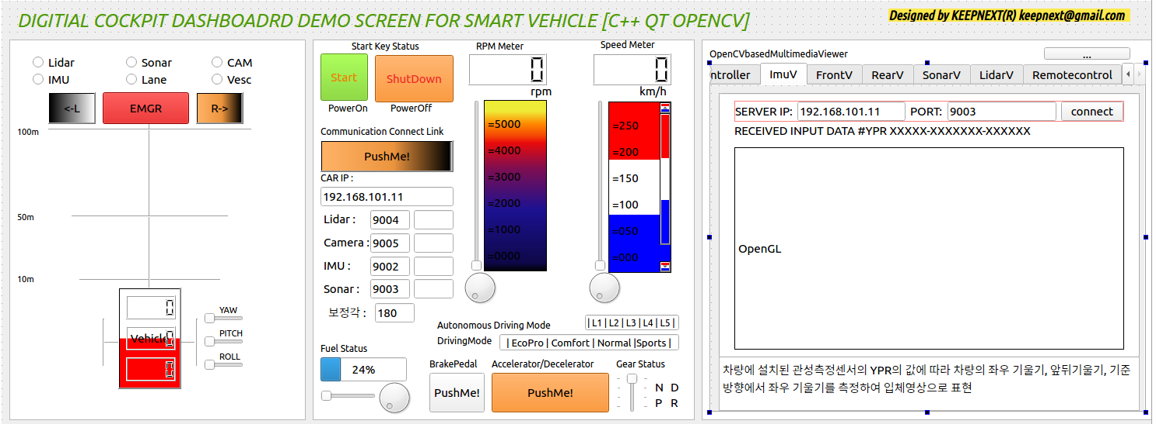
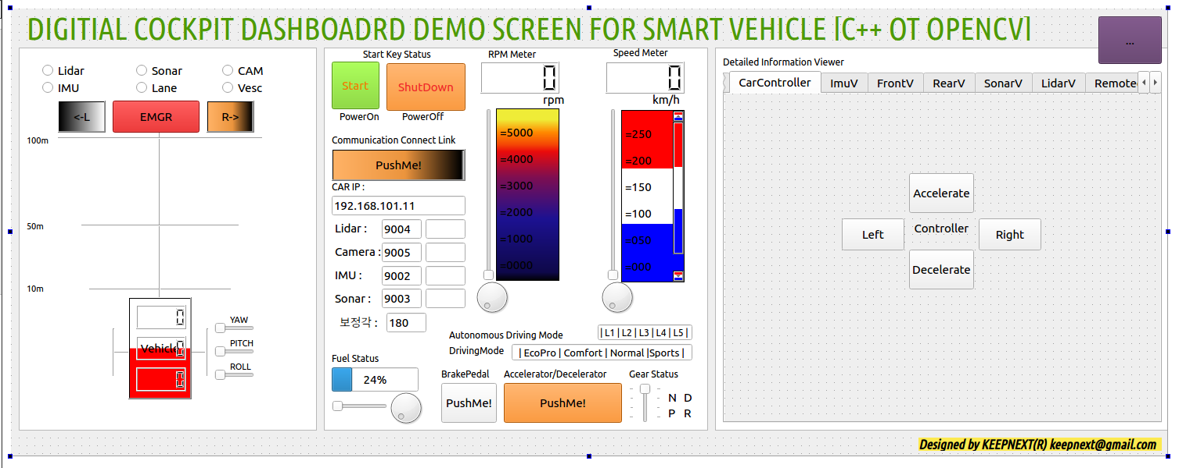
4.6 Cluster1
Management Dashboard Design and Development

Slide 55
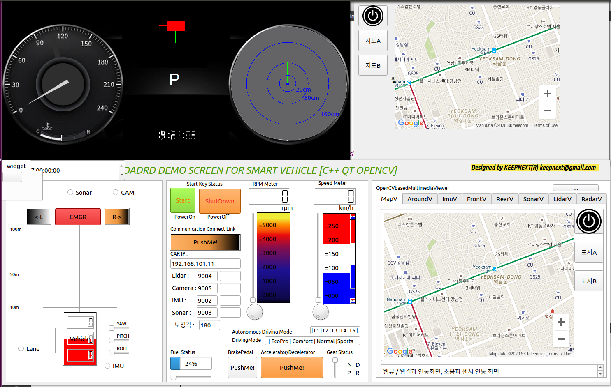
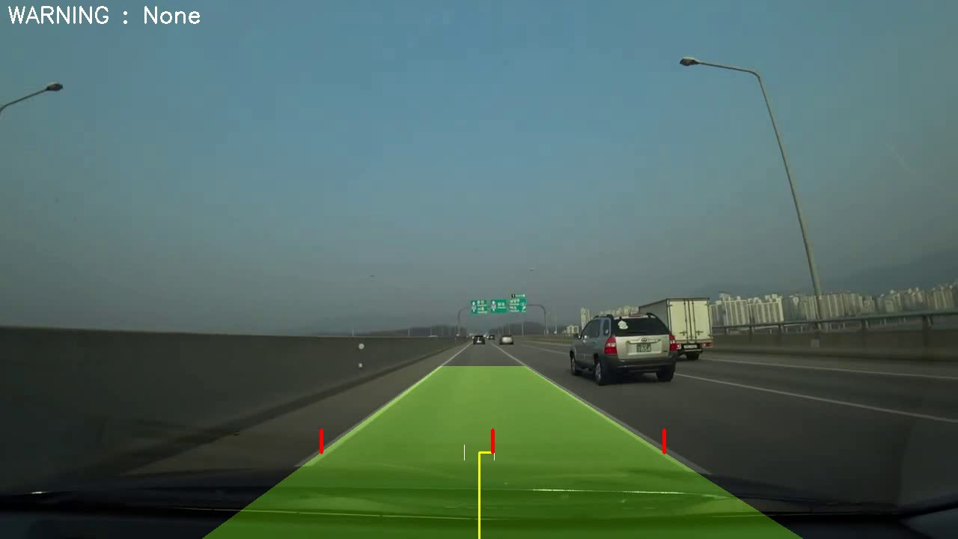
4.6 Cluster1
Management Dashboard Design and Development

Slide 56
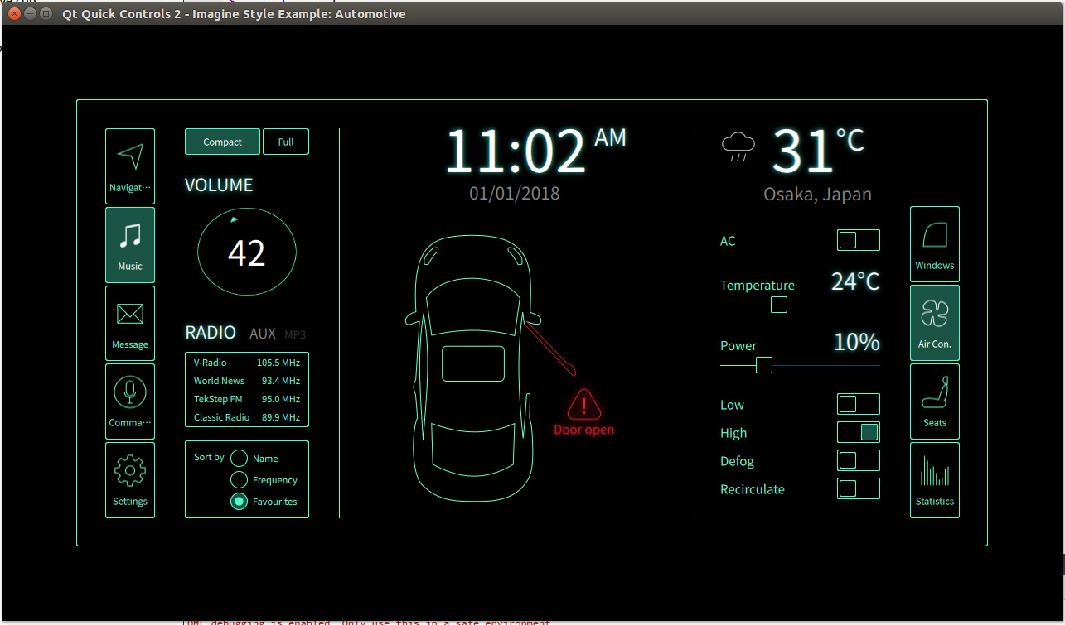
4.6 Cluster1
DigitalCockpitSystem Design and Development

Slide 57
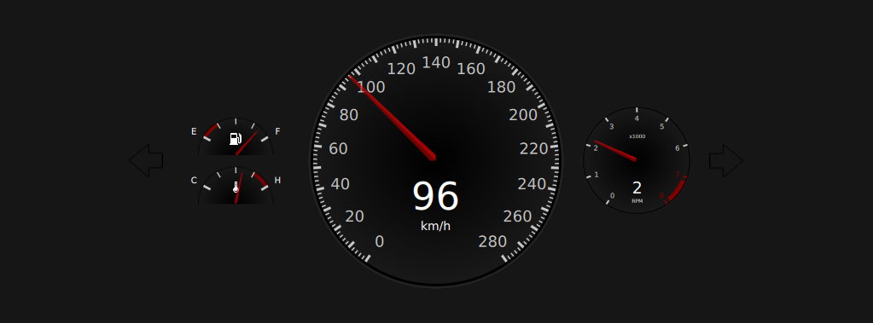
4.6 Cluster1
Unified Test

Slide 58
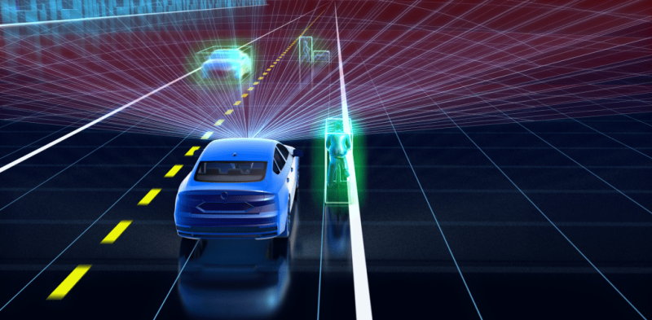
4.6 Cluster1
Lane Detection for ADAS

Slide 59
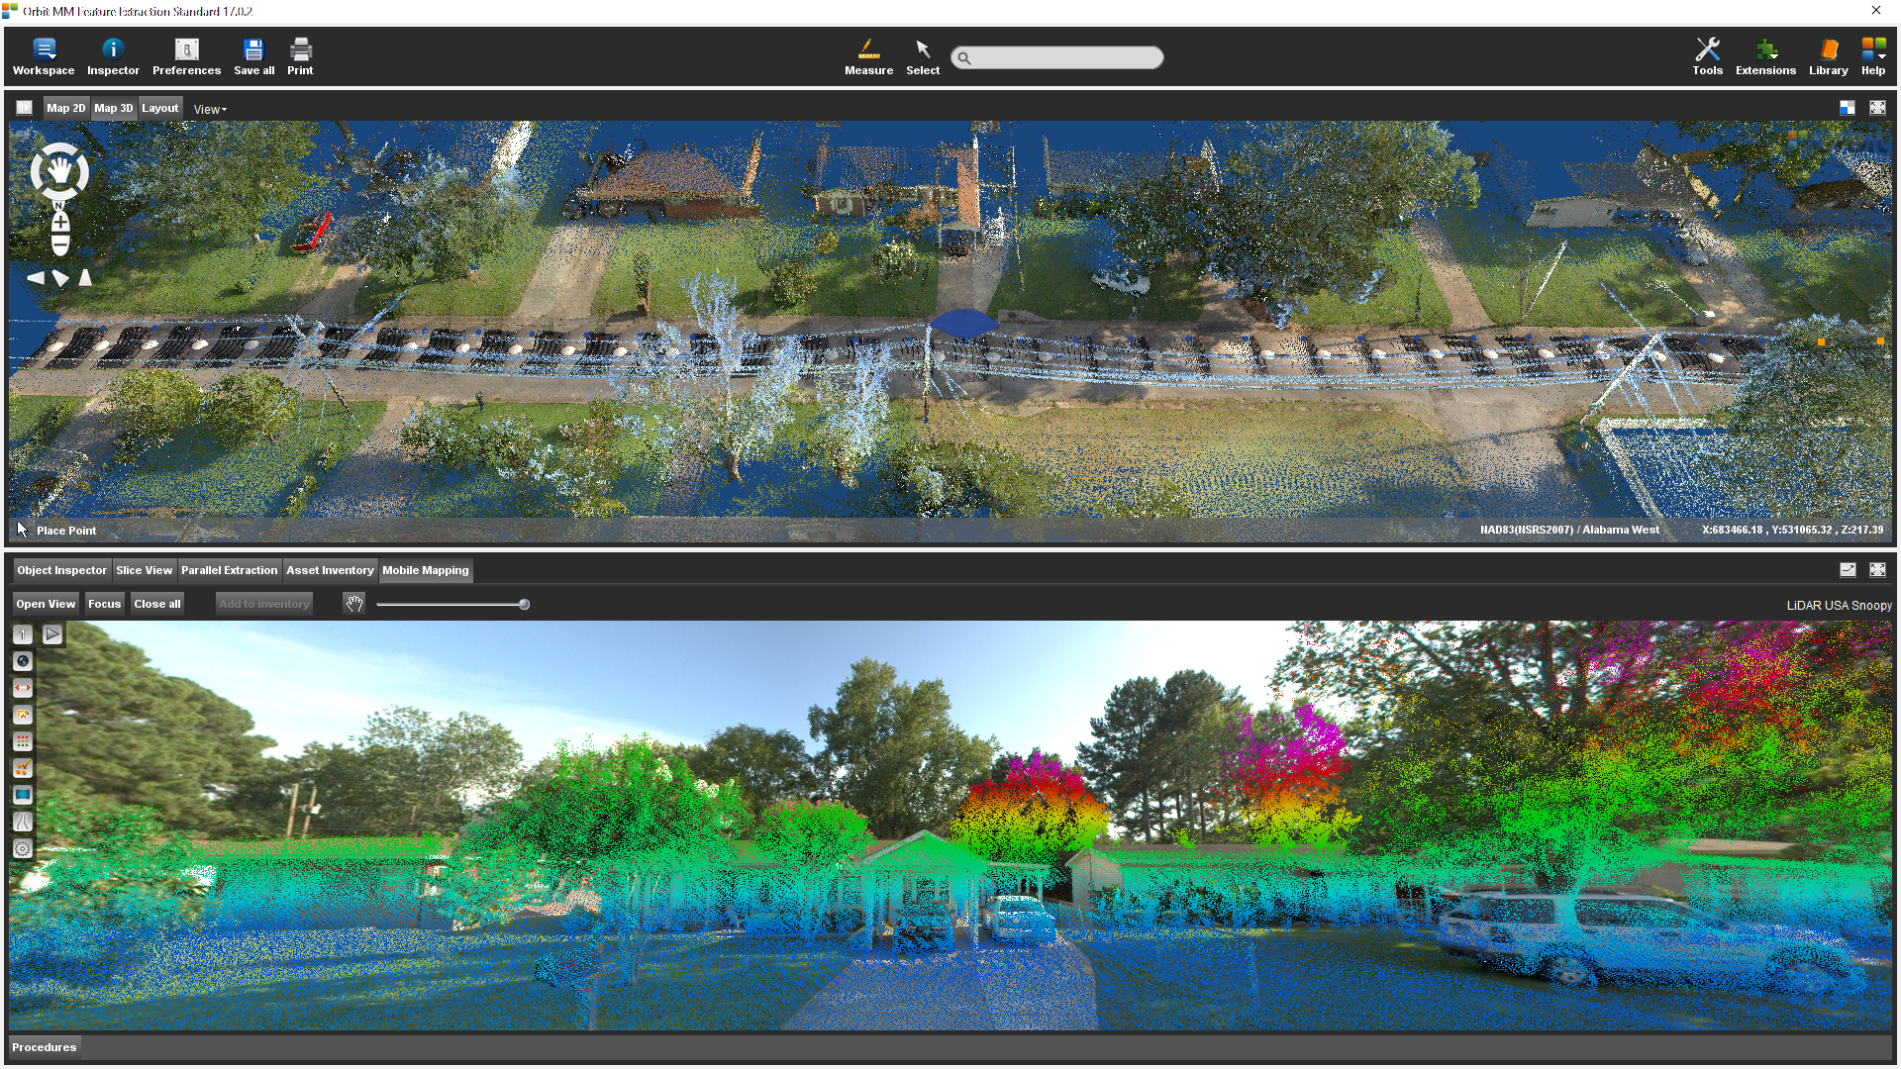
4.7 Cluster2
General View

Slide 60
4.8 Image Processing
General

Slide 61
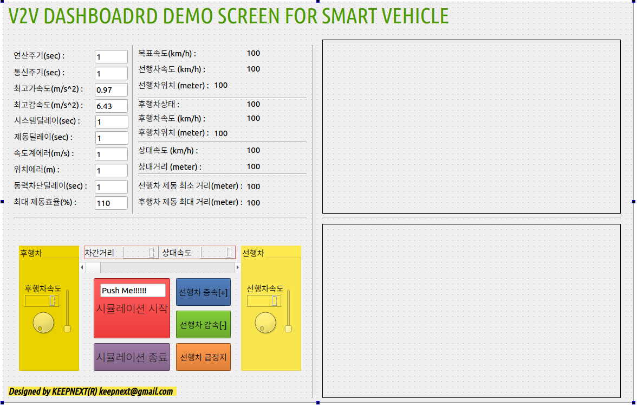
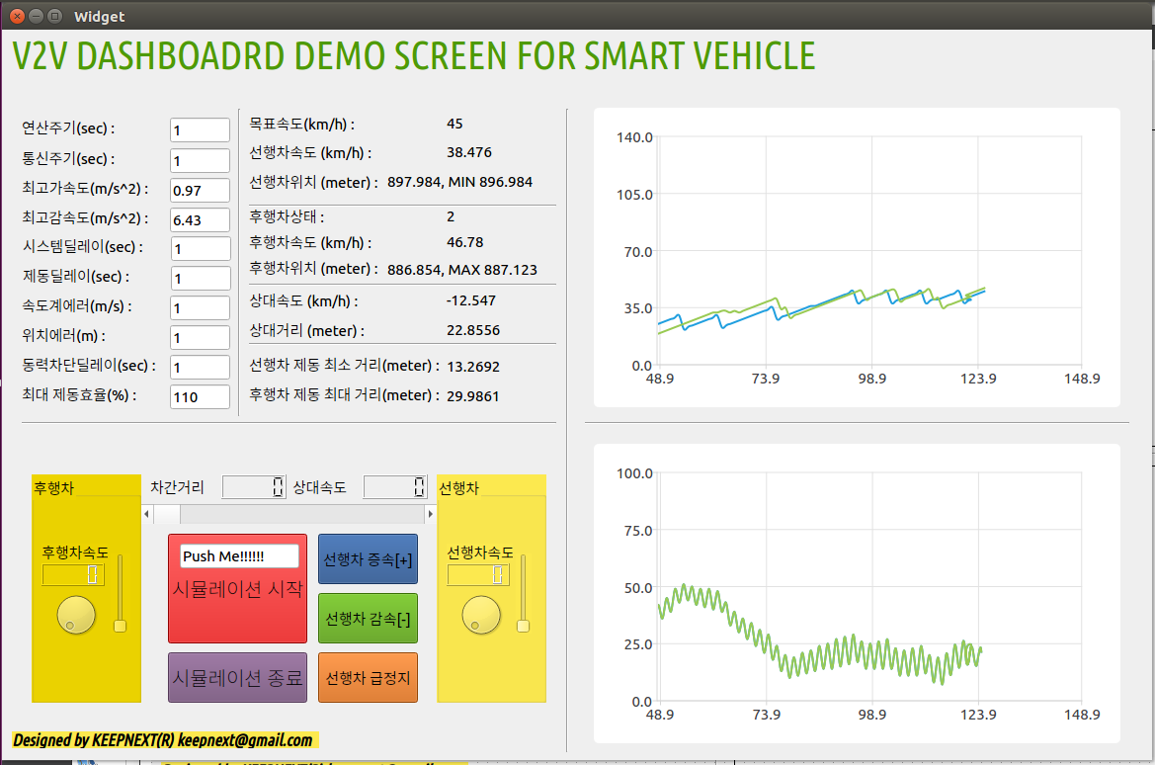
4.9 V2V
General

Slide 62
5. WRAP UP
5.1 Review & Summary
5.2 Insight
5.3 Future Works

Slide 63
5.1 Review & Summary
General

Slide 64
5.2 Insight
General

Slide 65
5.3 Future Works
General

Slide 66
APPENDIX
A.1 Data
A.2 Data
A.3 Reference

Slide 67
A.1 Reference
General

Slide 68
A.2 Reference
General

Slide 69
A.3 Reference
General

